Slide 1
Angular – Services and More Routing
Vignesh Murali Natarajan - 119780
Jason Monroe – 688776
Taryn Ernd - 785108

Slide 2

Objectives
In this session we would be covering the following topics:
Services in Angular
Injectable Decorator
Dependency Injection
Route Parameters
Creating in app-routing.module.ts
Linking
Retrieving parameters in component class
Child Routes

Slide 3
Services

Slide 4
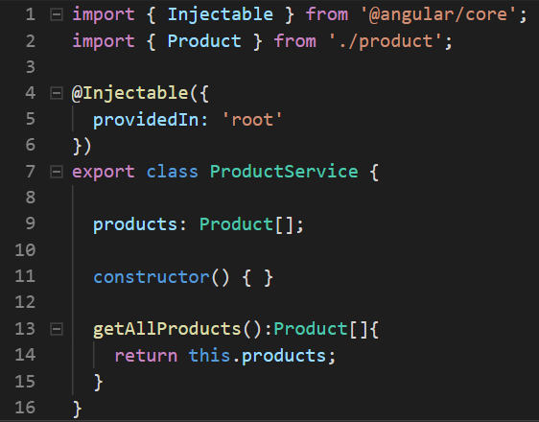
Services
Create a Service using the command:
Services expose methods (supposedly business logic) as API along with optional public properties.
Services are dependencies injected by Angular, which maintains each service as a singleton.
The @Injectable decorator is used to mark a Typescript class as a Service.
providedIn: Determines which injectors will provide the injectable, by either associating it with an @NgModule or other InjectorType, or by specifying that this injectable should be provided in the 'root' injector, which will be the application-level injector in most apps.
ng g service <<ServiceName>>

Slide 5
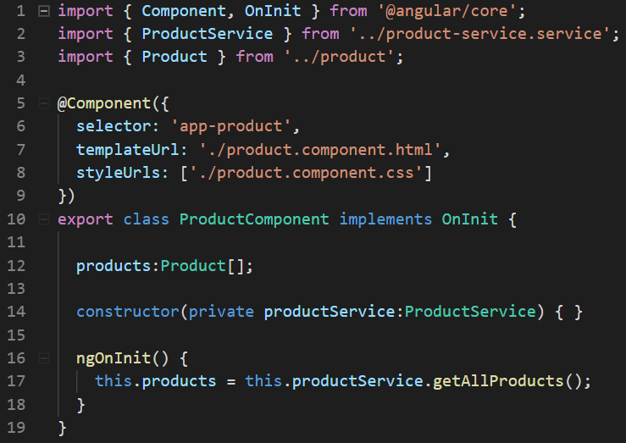
Dependency Injection
Import the service class
Define it within the constructor parameters
It should have the ‘private’ access modifier

Slide 6

HelloAngular – Add Developer Service
Generate Developer Service(ng g service developer)
Copy and move the dev array declaration and initialization from bio.component.ts to the new service developer
Update developer.ts class with an id field
Give each developer an id in the new Service
Create a method called getAllDevelopers and return the internal array.
Inject Developer Service into bio.component.ts
Dependency injection in constructor
Assign to class member/property
Notes:
Instructions to Trainer:
Instructions to Facilitator:

Slide 7
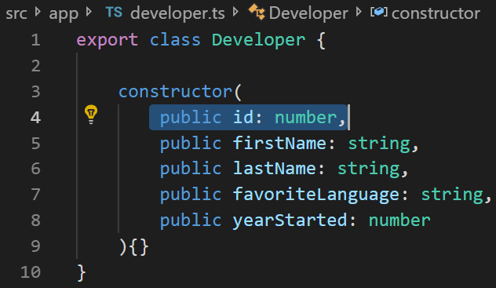
Add Id to Developer Model

Slide 8
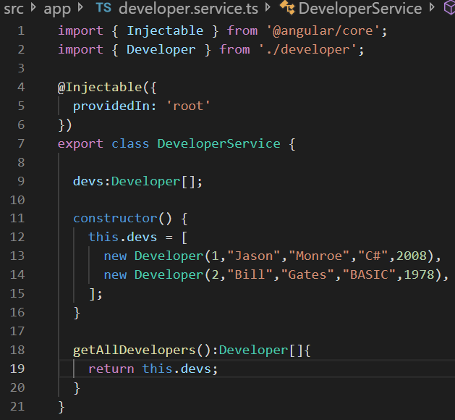
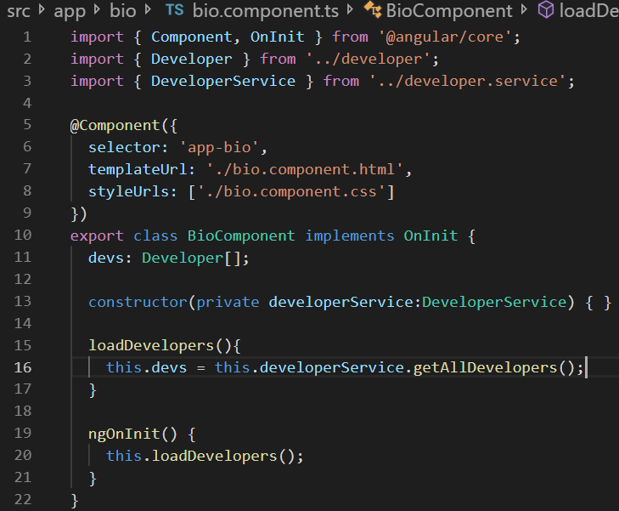
HelloAngular Developer Service
Service
Service injected into bio.component.ts

Slide 9
More Routing

Slide 10
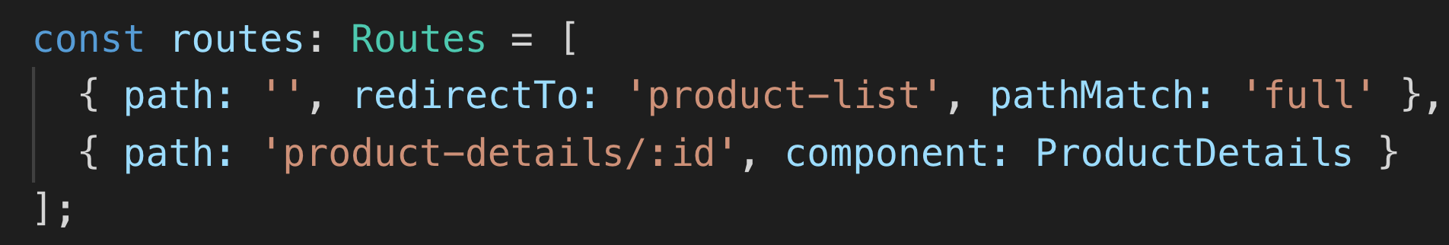
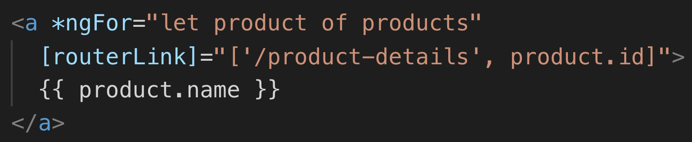
Sending Route Parameters
Parameters are sent using :paramName embedded on to the router paths:
The parameter can then be sent using routerLink and interpolation:
OR the routerLink directive may be used and supplied with parameters to be automatically sent, while invoking a router link.

Slide 11
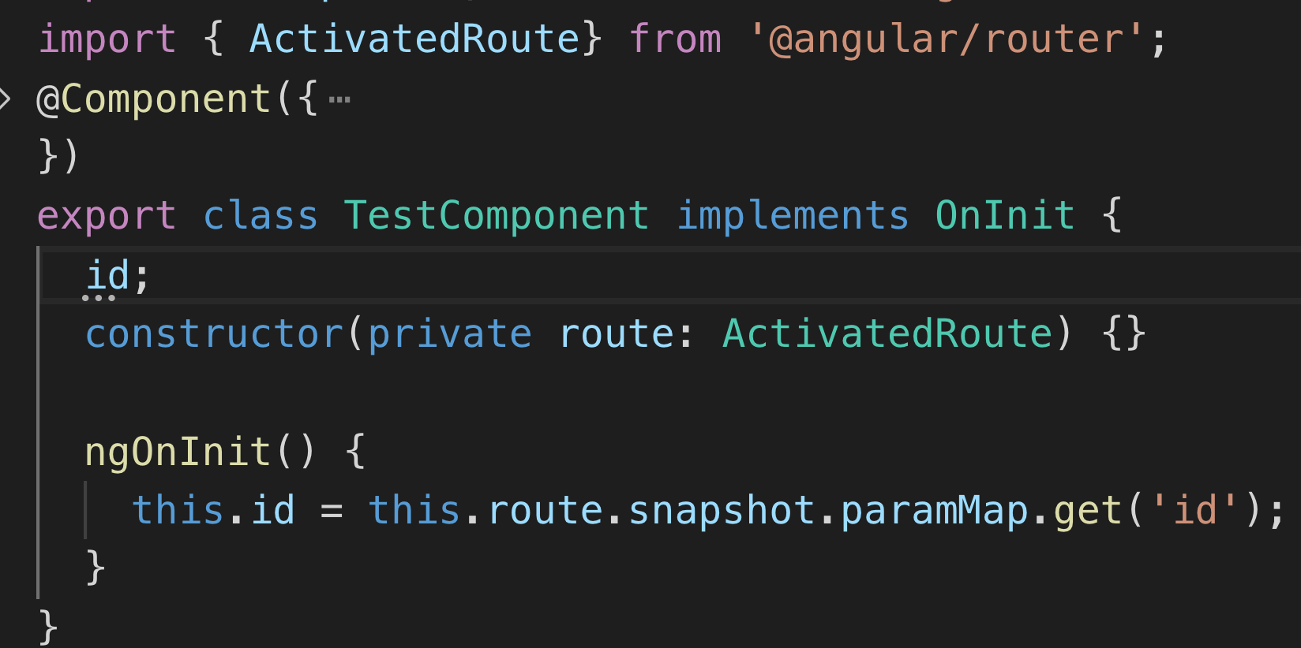
Routing Parameters
Reading Route Parameters:
Angular provides the ActivatedRoute service, which in turn supplies a paramMap property which contains the parameters.

Slide 12
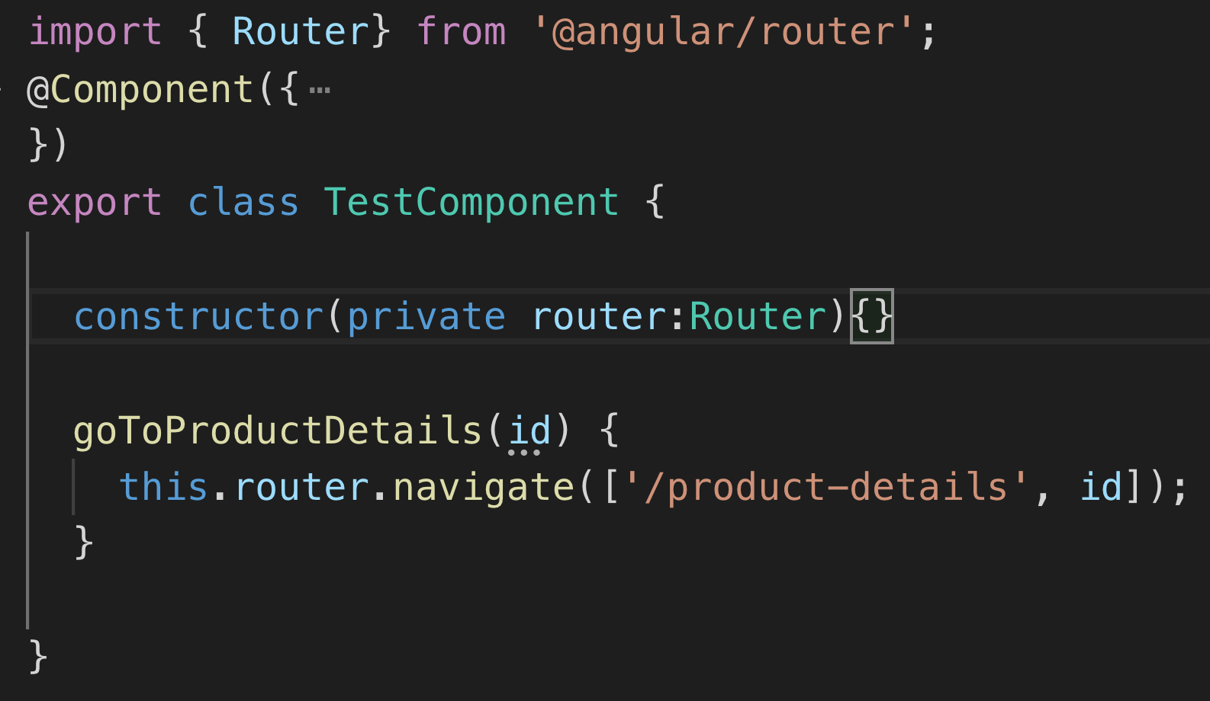
Routing Parameters
Navigating to parameterized routes internally:
Create a Router object and use the navigate method.
Pass an array containing the main route and the parameter (just like routerLink directive on previous page)

Slide 13
HelloAngular – Add Narbar Component to add modularity to design
Generate Navbar Component(ng g component Navbar)
Copy and paste <Nav></Nav> html tags from app.component.html to your new Navbar. component.html file
Make sure to comment out nav tag duplicated in app.component.html
Now add <Navbar> component tag to app.component.html
Update import within app.component.ts
Notes:
Instructions to Trainer:
Instructions to Facilitator:

Slide 14
HelloAngular – Add Route Parameters
Generate a new component called BioDetails (ng g component BioDetails)
Add a parameterized route to app-routing.module.ts
Import BioDetailsComponent
Create route with :id parameter that directs to BioDetails Component
Change bio.component.html
Only Display Developer’s name
Surround with routerLink pointing to bio/:id
Add method to DeveloperService to retrieve a Developer by Id
Call method getDeveloperById
Use .find() method and arrow syntax on devs array
Return developer object
Finish BioDetails
Inject an ActivatedRoute and DeveloperService Object
Use route snapshot to get paramMap.get(‘id’)
Use getDeveloperById method to store the developer in member / property
Display in bio-details.component.html
Notes:
Instructions to Trainer:
Instructions to Facilitator:

Slide 15
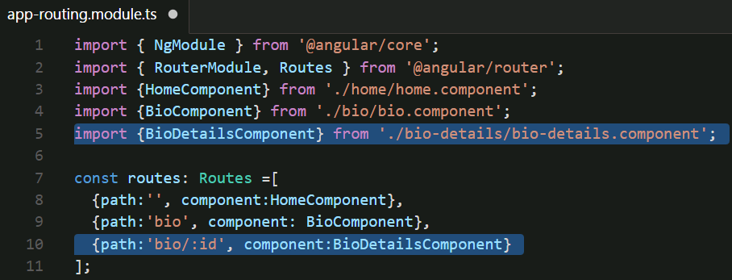
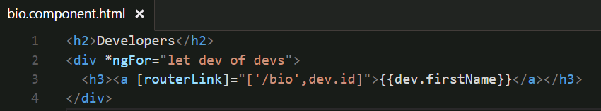
HelloAngular – Using Route Parameters
#2 ->
#3 ->

Slide 16
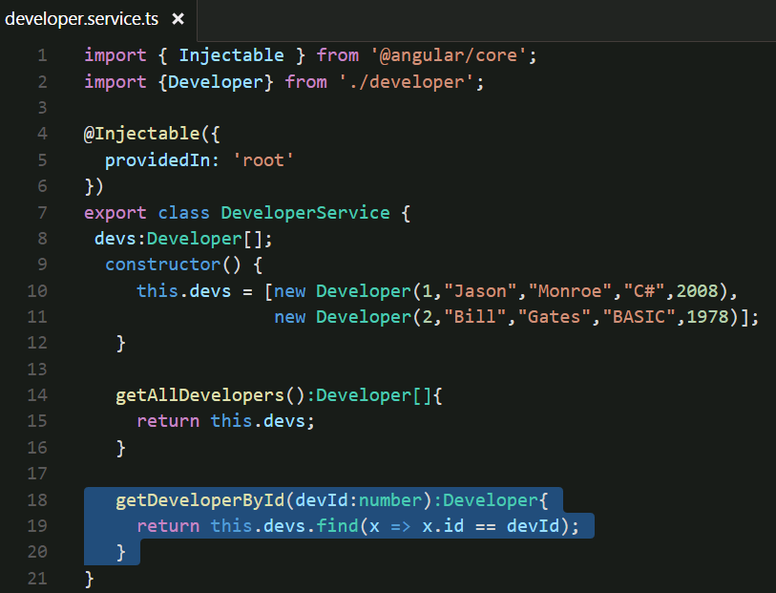
HelloAngular – Using Route Parameters
#4 ->

Slide 17
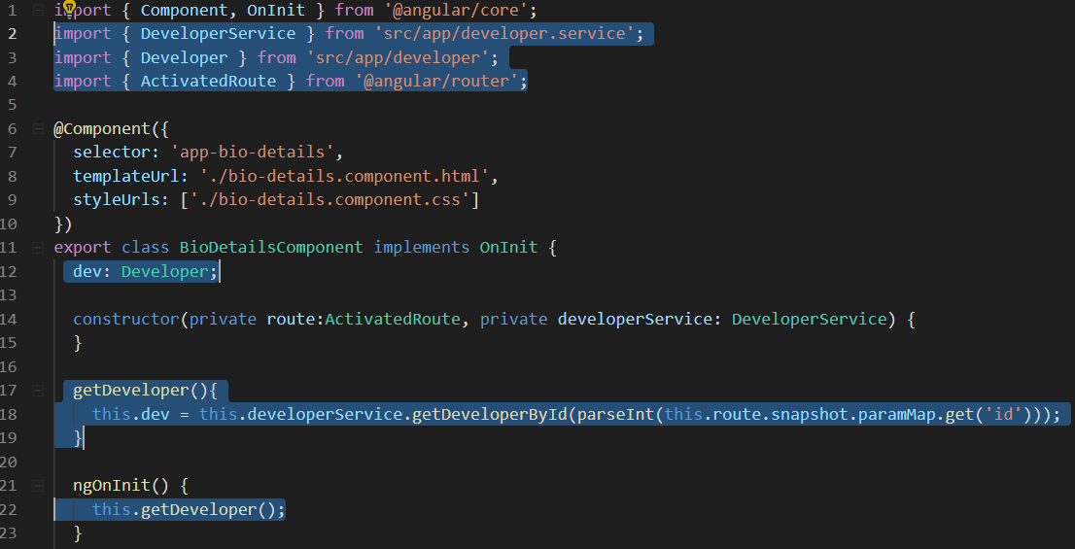
HelloAngular – Using Route Parameters
#5 ->

Slide 18
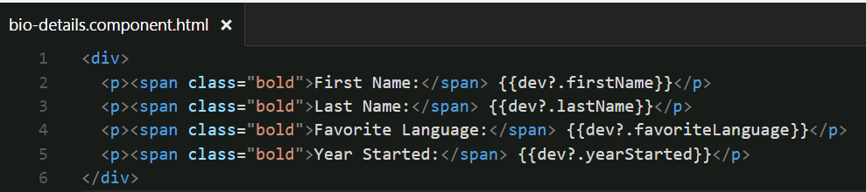
HelloAngular – Using Route Parameters
#6

Slide 19
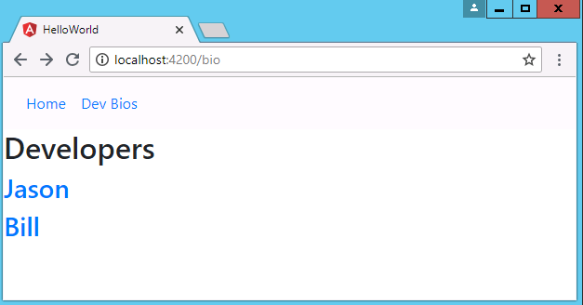
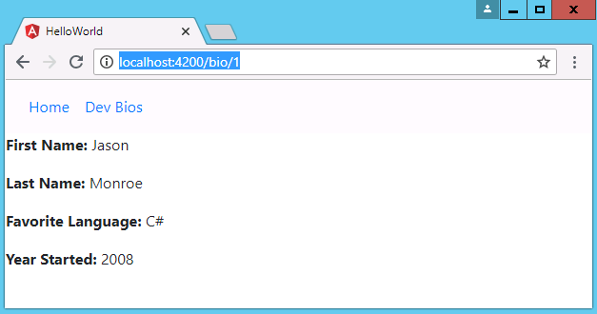
HelloAngular – Using Route Parameters

Slide 20
Child Routes

Slide 21
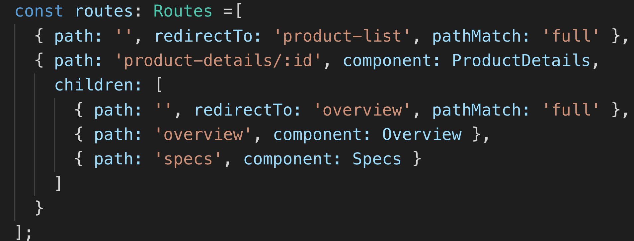
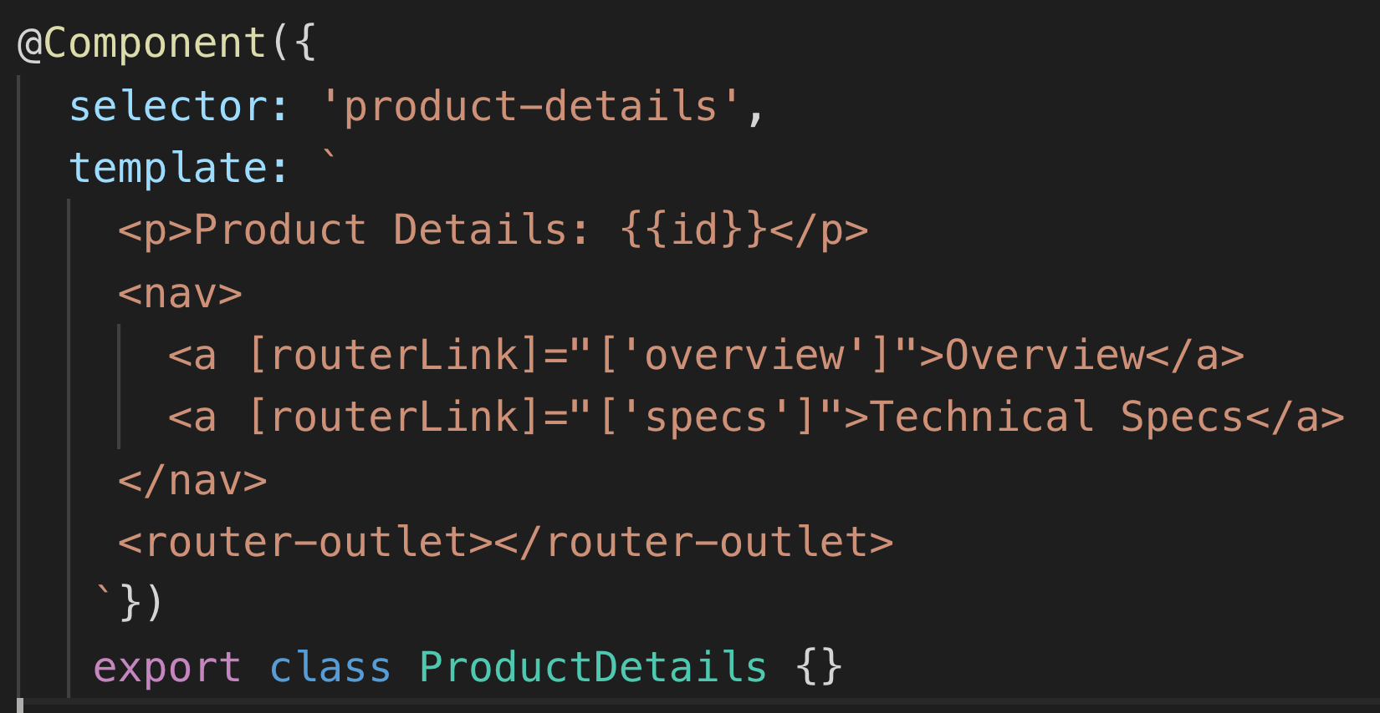
Route Children
When some routes may only be accessible and viewed within other routes, it may be appropriate to create them as child routes.
The component with the children routes must have a router-outlet to hold the output of the children.

Slide 22

Learn How - Demonstration
Demo: Router Children
https://github.com/Cognizant-Angular/Angular-Child-Routes
Notes:
https://github.com/Cognizant-Angular/Angular-Child-Routes

Slide 23
Review
Services
ng g s <<name>>
@Injectable
DI
Route Params
{ path: ‘path/:param’ component: Component }
ActivatedRoute
this.route.snapshot.paramMap.get(‘param’)
Child routes

Slide 24
Course Objective:
At the end this 90 min session, you will be able to
Create an Angular service
Implement route parameters in an Angular application

Slide 25
What is a Service?
How do you create a Service?
What is Dependency Injection?
What is Routing?
How to pass parameters to a route?
How do you create Child Routes?

Slide 26
Thank You

